Slide 1
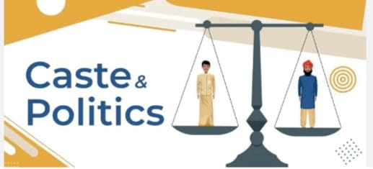
Caste and politics

Slide 2
What is caste?
Caste is a term that is used to define a system of social stratification that is based on an individual’s birth .The system of social stratification based on birth is called caste system.
The term is mostly common in India but it is also used in some other parts of the world .
The caste system determines your labor and your level of spiritual purity in the society .
In India, when a child is born his /her status on the social hierarchy gets fixed on the basis of the caste he /she is born into .

Slide 3
Definitions of caste
According to Jai Prakash Narayan, “caste is the most important political party in India .”
According to Morris Jones, “The central discovery is that politics is more important to caste and caste is more important to politics than before.”
According to Charles coole, “when a class somewhat strictly hereditary, we may call it a caste .”

Slide 4
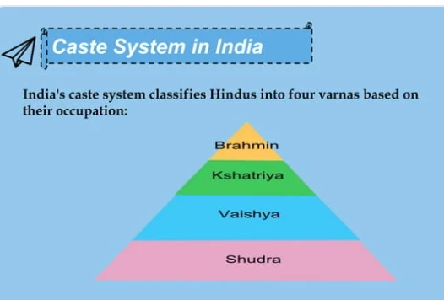

Slide 5
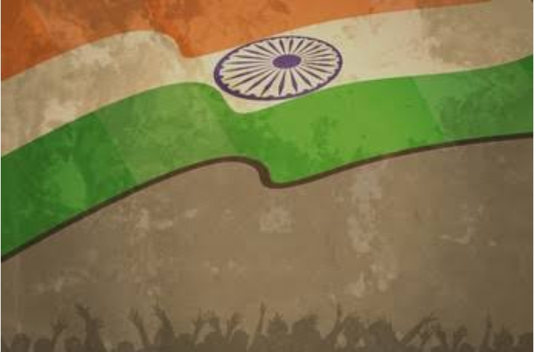
Indian Politics

Slide 6
Politics in India
The term politics has been derived from a Greek word called “politika” which means “affairs of the cities”.
Politics is the set of activities that are associated with making decisions in groups or other forms of power relations among individuals , such as the distribution of resources or status
Politics of India works within the framework of the county’s constitution.
The politics of India is based on a multi-party system.
India is a parliamentary secular democratic republic in where the president of India is the head of state & first citizen of India and prime minister of India is the head of government.

Slide 7
Impact of caste on politics in India
Caste based political parties
Caste based pressure groups
Caste and nomination of candidates for elections
Caste and voting behavior
Caste and formation of council of ministers
Caste and reservation
Demand of reservation by other communities
Social and political tensions
Dissatisfaction among the people belonging to higher castes
Caste and policy making
Caste based census
Caste clashes
Emergence of elite class among scheduled caste and scheduled tribes

Slide 8
Impact of politics on caste in India
Abolition of untouchability
Special provisions for the upliftment of scheduled castes and scheduled tribes
Reservations of seats of scheduled castes, scheduled tribes and OBCs
Provision of equal franchise
broken the strong barriers between high and low castes
Emergence of new consciousness among SC and ST
Emergence of caste elite
Increase in political participation
Increase in the political participation of women belonging to SC and ST.

Slide 9
THANK YOU

